Slide 1
ICN MLI
January 13-15, 2015
Machine Learning Engineering
Daniel Dahlmeier
https://github.wdf.sap.corp/I073941/ml-bootcamp
Image credits: bestfreejpg.com

Slide 2
How to build systems involving Machine learning?

Slide 3
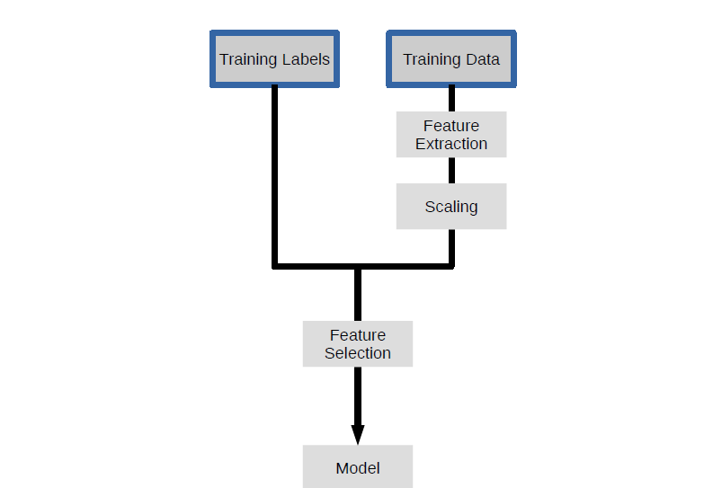
Recap:
a machine learning pipeline
Production Data
Feature Extraction
Scaling
Prediction
Application

Slide 4
Machine learning expert workflow:
Input: data and task
Output: model
While ( not accurate ) {
Pre-process data
Engineer features
Train model
Test model
}

Slide 5
Software engineer workflow:
Input: model and specification
Output: workable software system

Slide 6
Machine learning model is just another module, right?

Slide 7
Traditional software engineering: about functionality and modeling
ML system: about data transformations

Slide 8
80/20 rule: 80 percent of the code is about data transformations and feature extractions, 20 percent about Machine learning.

Slide 9
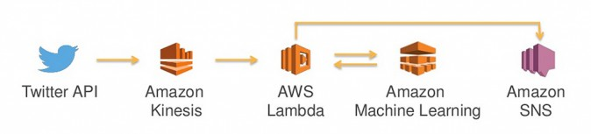
Example architecture: AWS
http://cloudacademy.com/blog/aws-reinvent-2015-machine-learning-application/

Slide 10
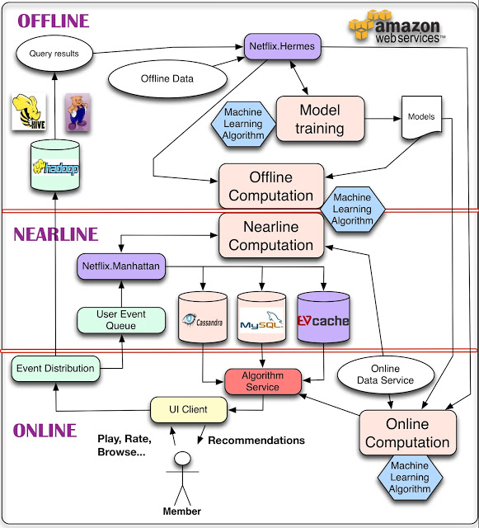
Example architecture: Netflix
http://techblog.netflix.com/2013/03/system-architectures-for.html

Slide 11
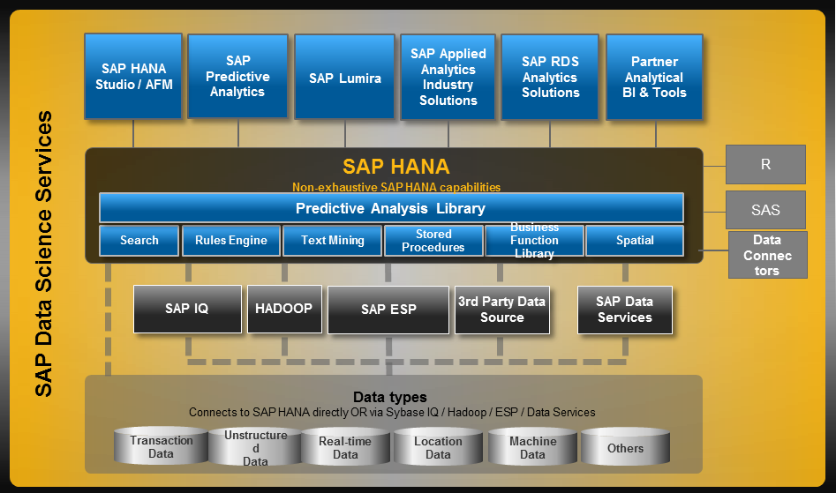
Example architecture: Hana predictive analysis library (PAL)

Slide 12

Example architecture: Hybris profile
Feature Processing and Streaming
YaaS ML Services
Apache Flink
Kafka with lookup on keys
Machine Learning: Spark, Flink and other Cloud Ready solutions
Feature Processing
ML Services (Service Endpoint)
Kafka
Training Set
Model training (Continuously and Batch)
Model Repository
Aggregate Stores
Research, Exploration and Refinement of Models
deploy algorithms and to ML cloud infrastructure
Historical Data: Big Data Layer: S3 or HDFS in combination with Parquet, ORC or Avro
Export data for research (Hive)
Export
Workstation or offline cluster
Historical Data, Legacy Systems, Other Sources…

Slide 13
Building system with Machine learning is essentially about building data pipelines.

Slide 14
Software architecture principles:
Modularity
Reusability
Testability
…
..some of these get a lot harder

Slide 15
New challenges in ML systems:
Culture gap between data scientists and engineers
Integration of ML workflow
Performance vs accuracy
Model life cycle
deployment, versioning, monitoring, re-training
Data management
extraction, storage, cleaning, ‘wrangling’, annotation, versioning

Slide 16
Been there: lessons from CityApp recommender

Slide 17
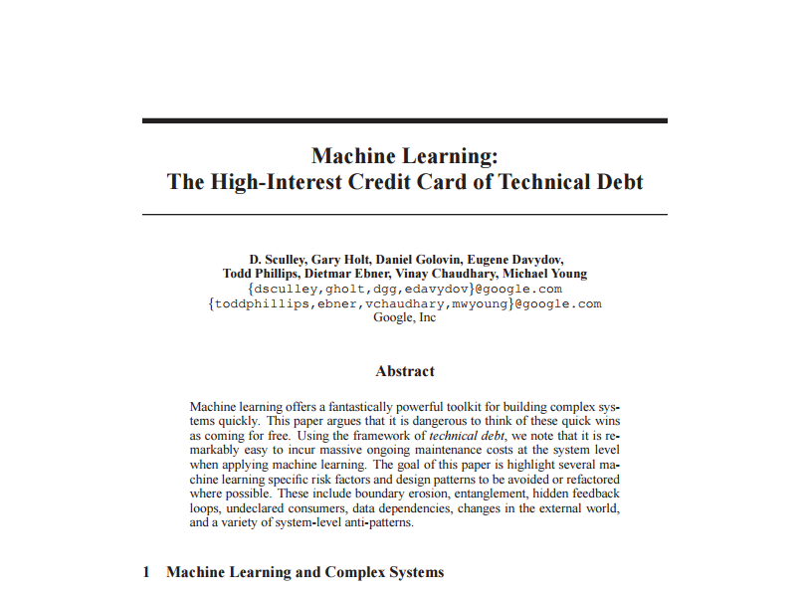
From Google.
Design patterns in machine learning systems

Slide 18
Complex models erode boundaries
CACE principle: changing anything changes everything

Slide 19
Data Dependencies

Slide 20
System-level Spaghetti

Slide 21
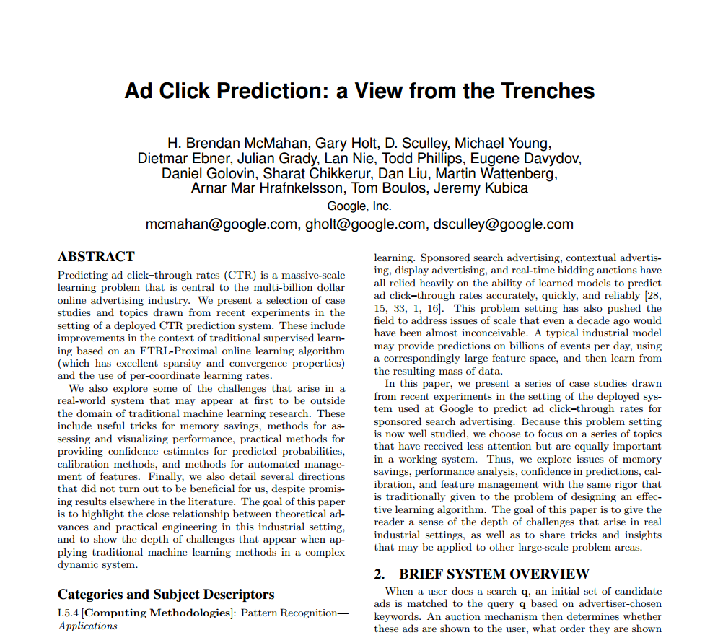
More lessons from Google

Slide 22
https://github.wdf.sap.corp/I073941/ml-bootcamp

